Slide 1



The Building Regulations
What can we expect from MHCLG?
London Building Control
13 Woodstock Street, Mayfair, London, W1C 2AG
Tel: 0207 099 3636 info@londonbuildingcontrol.co.uk
www.londonbuildingcontrol.co.uk

Slide 2



The Building Act 1984 (as amended)
The Building Regulations 2010 (as amended)
Fire Safety Review
Joint Competence Authority
Future Homes Standard
Approved Documents B, F, L, M
Other considerations
Tel: 0207 099 3636 * info@londonbuildingcontrol.co.uk * www.londonbuildingcontrol.co.uk
ISO9001 Certified

Slide 3
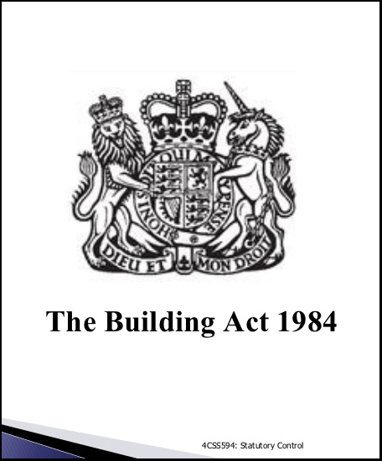
The Building Act 1984
(as amended)
To bring about changes to the current system, including the formation of The Joint Competent Authority (JCA), changes to the primary legislation will need to be made and Government may take the opportunity to set out a
new Act
Statute
Tel: 0207 099 3636 * info@londonbuildingcontrol.co.uk * www.londonbuildingcontrol.co.uk
ISO9001 Certified

Slide 4
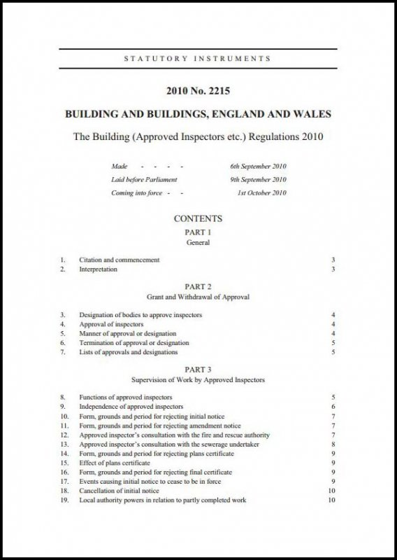
The Building Regulations 2010 (as amended)
New requirements either being currently consulted or due to be released. Sign up to MHCLG alerts to receive regular updates;
Part B Part L Part F Part M The Building Regulations 2020?
Functional requirements
Tel: 0207 099 3636 * info@londonbuildingcontrol.co.uk * www.londonbuildingcontrol.co.uk
ISO9001 Certified

Slide 5
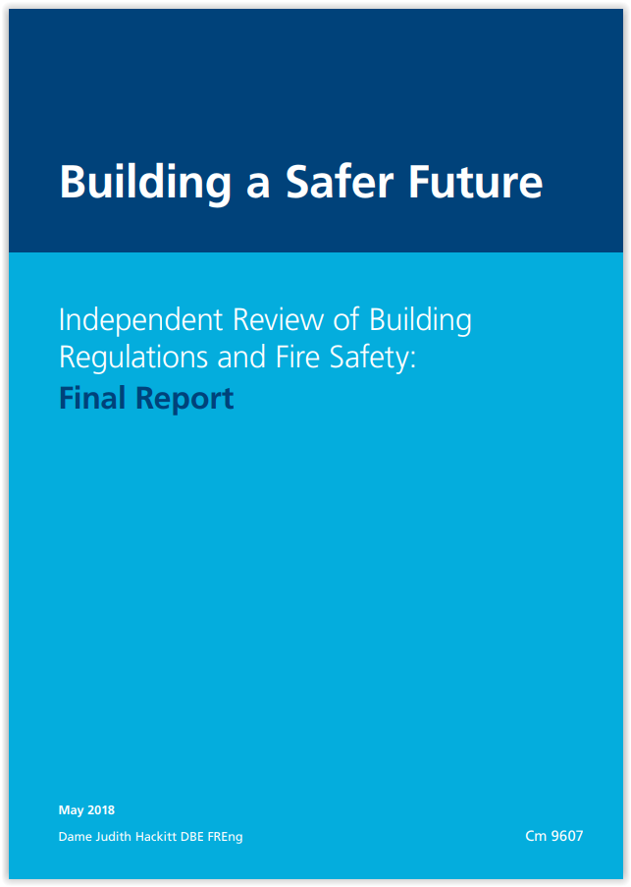
Dame Judith Hackitt named as Government Advisor on the new Building Safety Regulator
Dame Judith Hackett will provide independent advice to the government on how best to establish the powerful new Building Safety Regulator.
Guidance
Tel: 0207 099 3636 * info@londonbuildingcontrol.co.uk * www.londonbuildingcontrol.co.uk
ISO9001 Certified

Slide 6
Government committed to delivering the biggest change in building safety for a generation
Housing Secretary announces the new Building Safety Regulator within the Health and Safety Executive, to be established immediately
Governments sets out clarified and consolidated advice for building owners, proposal to extend cladding ban, update on fire sprinklers
Response to Phase 1 of the Grenfell Tower Public Inquiry published
Building owners who have not take action to make their buildings safe will be named from next month
Tel: 0207 099 3636 * info@londonbuildingcontrol.co.uk * www.londonbuildingcontrol.co.uk
ISO9001 Certified

Slide 7
Government commits to new independent building safety regulator
The government has committed to creating an independent building safety regulator as part of the ‘biggest reforms to the building safety regime in nearly 40 years’
The move, which confirms proposals outlined by the Government in June, was spelt out in yesterday’s Queen’s Speech (14 October).
Tel: 0207 099 3636 * info@londonbuildingcontrol.co.uk * www.londonbuildingcontrol.co.uk
ISO9001 Certified

Slide 8
It was announced as part of a clutch pf new measures addressing all 53 of Judith Hackitt’s recommendations from her independent review of building regulations which she put forward following the Grenfell Tower fire in June 2017.
The new regulator would oversee compliance with safety regulations by contractors, designers and building owners. According to Housing Secretary, Robert Jenrick, the watchdog would have ‘powers to enforce criminal sanctions’.
The wider legislative changes pledged by Prime Minister, Boris Johnson’s government also include spelling out a clearer scope of accountability and duties throughout the buildings design, construction and occupation.
Tel: 0207 099 3636 * info@londonbuildingcontrol.co.uk * www.londonbuildingcontrol.co.uk
ISO9001 Certified

Slide 9

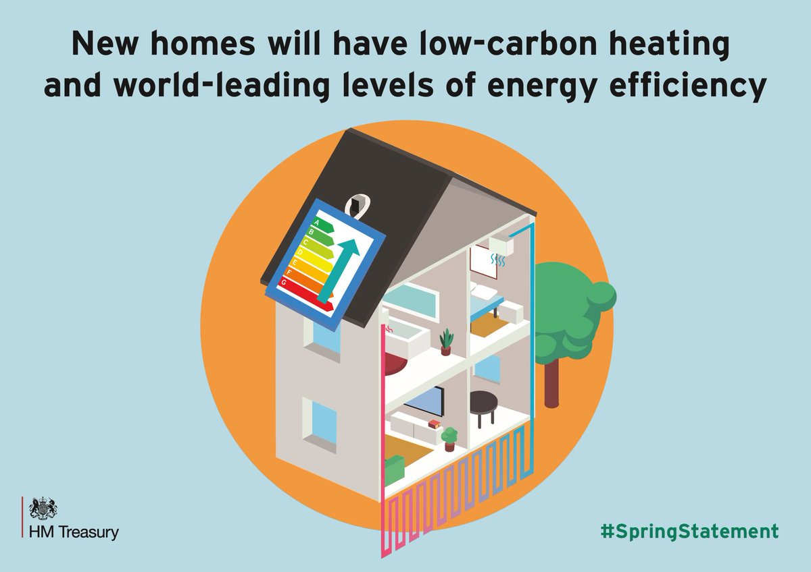

The Future Homes Standard
2019 Consultation on changes to Part L (conservation of fuel and power) and Part F (ventilation) of the Building Regulations for new dwellings.
Tel: 0207 099 3636 * info@londonbuildingcontrol.co.uk * www.londonbuildingcontrol.co.uk
ISO9001 Certified

Slide 10
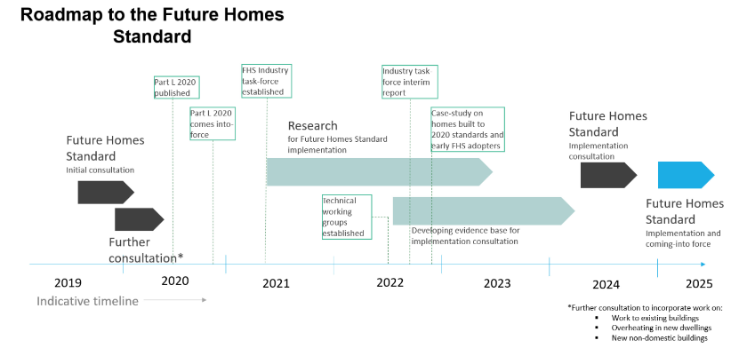
Tel: 0207 099 3636 * info@londonbuildingcontrol.co.uk * www.londonbuildingcontrol.co.uk
ISO9001 Certified

Slide 11
The UK has set in law in target to bring all its greenhouse gas emissions to net zero by 2050 – one of the most ambitious targets in the world. Homes – both new and existing – accounts for 20% of emissions. Despite progress reducing emissions from homes, we need to go much further. New homes being built now and in the next 5-10 years will still exist in 2050 and therefore we must ensure that the energy efficiency standards we set for them put us on track to meet the 2050 target.
Tel: 0207 099 3636 * info@londonbuildingcontrol.co.uk * www.londonbuildingcontrol.co.uk
ISO9001 Certified

Slide 12
We expect to launch a further consultation in the coming months addressing existing domestic buildings, and new and existing non-domestic buildings. This initial consultation relates to new domestic buildings; and includes change to part F.
Tel: 0207 099 3636 * info@londonbuildingcontrol.co.uk * www.londonbuildingcontrol.co.uk
ISO9001 Certified

Slide 13
2019 Consultation on changes to part L (conservation of fuel and power) and Part F (ventilation) of the Building Regulations for new dwellings
Option 2: 31% reduction in carbon emissions compared to the current standard. We anticipate this could be delivered based on the installation of carbon-saving technology such as photovoltaic (solar) panels and better fabric standards, though not as high as in Option 1 (typically double not triple glazing).
Option 2 is our preferred option. It would deliver more carbon savings and results in lower bills for the householder but has higher build costs. We also expect that it would help to prepare supply chains for heat pumps and increase the number of trained installers.
Tel: 0207 099 3636 * info@londonbuildingcontrol.co.uk * www.londonbuildingcontrol.co.uk
ISO9001 Certified

Slide 14
The Future Homes Standard builds on the Grand Challenge Buildings Mission to at least halve the energy use of new buildings by 2030.¹⁰ As outlined in Chapter one, both new and existing homes account for 20% of greenhouse gas emissions in the UK.¹¹ By making our homes and other buildings more energy efficient and embracing smart and low carbon technologies, we can improve the comfort and energy efficiency of people’s homes and boost economic growth while meeting our targets for carbon reduction.
Tel: 0207 099 3636 * info@londonbuildingcontrol.co.uk * www.londonbuildingcontrol.co.uk
ISO9001 Certified

Slide 15
Gas boilers will be banned in new homes from 2025 in a bid to tackle emissions, the government has announced.
Phillip Hammond said new standards “mandating the end of fossil fuel heating systems in new homes from 2025 delivering lower carbon and lower fuel bills too”.
The report from the committee on climate change said it would cost £4,800 to install low-carbon heating in a new home, but £26,300 in an existing house.
Around 14% of UK greenhouse gas emissions came from homes and last year emissions from housing increased – mainly from gas boilers.
Tel: 0207 099 3636 * info@londonbuildingcontrol.co.uk * www.londonbuildingcontrol.co.uk
ISO9001 Certified

Slide 16
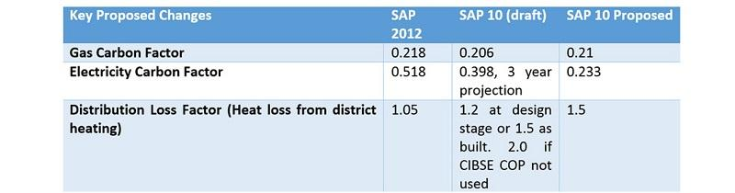
SAP 10
Heat pumps are amongst the products set to benefit from the update, with an increased benefit in specifying electric heating solutions too, Dimplex Heating & Ventilation, which includes the Dimplex (heating), Xpelair (air) and Redring (water) brands, as well as the new Zeroth Energy System.
Tel: 0207 099 3636 * info@londonbuildingcontrol.co.uk * www.londonbuildingcontrol.co.uk
ISO9001 Certified

Slide 17
Transitional Provisions Government will close out the ‘time lag’ which currently exists whereby developers can build new homes to outdated requirements, particularly in respect of Part L They are aware that some homes, which are currently under construction, reflect pre 2013 insulation standards, and whilst this is technically allowable under the current transitional provisions, it is quite unacceptable
Tel: 0207 099 3636 * info@londonbuildingcontrol.co.uk * www.londonbuildingcontrol.co.uk
ISO9001 Certified

Slide 18
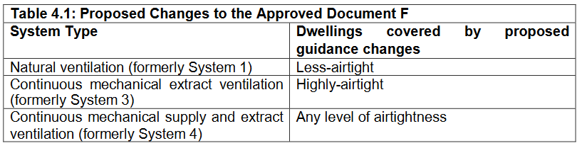
2019 Consultation on changes to Part L (conservation of fuel and power) and Part F (ventilation) of the Building Regulations for new dwellings
To investigate whether the ventilation provisions for good indoor air quality set out in Part F 2010 were effective, MHCLG commissioned research into ventilation and indoor air quality in new homes, and the full research report is published alongside this consultation. The research suggested that a large proportion of home may be failing to meet the technical standards set out in Approved Document F. This led to poor indoor air quality in several of the sample of houses tested. The research also identified some issues where people shut trickle ventilators or turned off extractor fans to reduce noise.
Tel: 0207 099 3636 * info@londonbuildingcontrol.co.uk * www.londonbuildingcontrol.co.uk
ISO9001 Certified

Slide 19
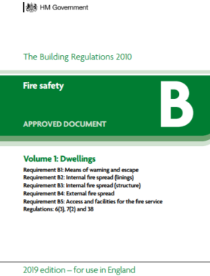
Approved Document B Volume 1 now contains Flats (as L & M) Limited or non-combustible over 18m Special attachments
Tel: 0207 099 3636 * info@londonbuildingcontrol.co.uk * www.londonbuildingcontrol.co.uk
ISO9001 Certified

Slide 20
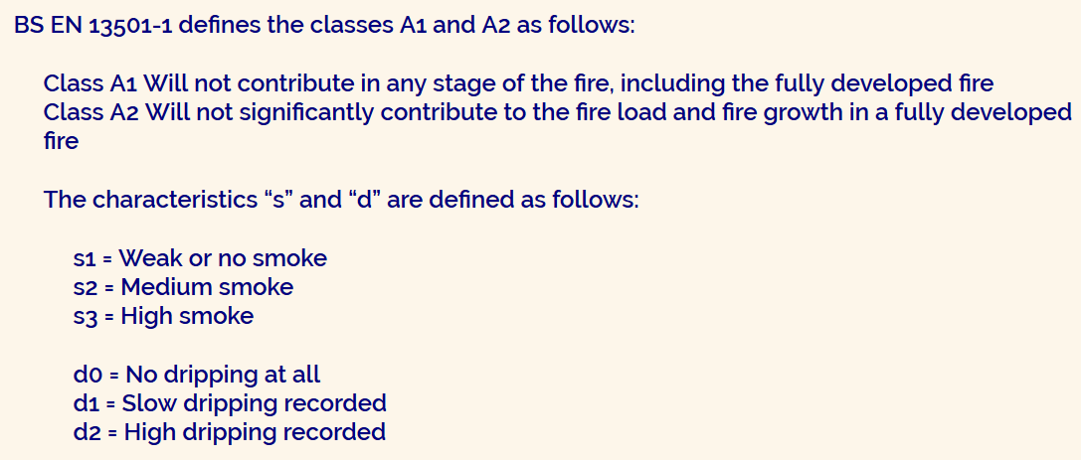
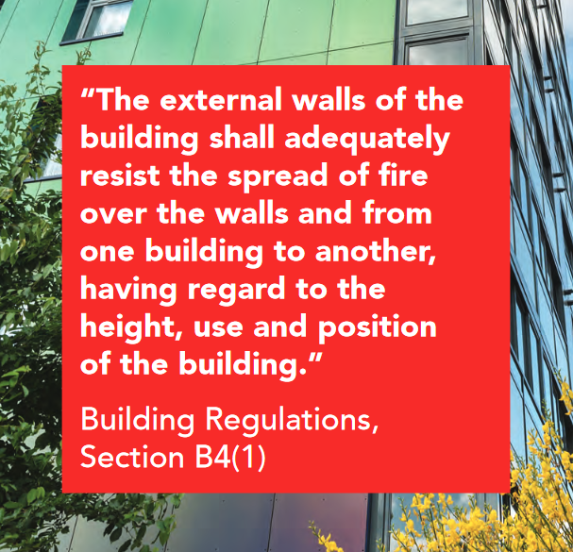
(2) Subject to paragraph (3), building work shall be carried out so that materials which become part of an external wall, or specified attachment, of a relevant building are of European Classification A2-S1, d0 or A1, classified in accordance with BS EN 13501-1:2007+A1:2009 entitled, ‘Fire classification of construction products, and building elements. Classification using test date from reaction to fire tests “(ISBN 978 0 580 59861 6) published by the British Standards Institution on 30 March 2007 and amended in November 2009.
Tel: 0207 099 3636 * info@londonbuildingcontrol.co.uk * www.londonbuildingcontrol.co.uk
ISO9001 Certified

Slide 21
“Relevant” buildings over 18m must be constructed or refurbished using only materials in the external wall which meet the limited combustibility requirement of A2-S1, do * or better which is currently referred to in terms of a ‘new ban’.
Relevant buildings are defined below in new paragraph (4) of the Regulation.
The guidance in Approved Document B for any other building over 18m states that materials in the external wall should meet the limited combustibility requirement of A2-S3, d2 or better.
The new paragraph (3) details those components that are exempt from the ban, which applies to the entire external wall construction, and not just the cladding.
Tel: 0207 099 3636 * info@londonbuildingcontrol.co.uk * www.londonbuildingcontrol.co.uk
ISO9001 Certified

Slide 22
(4) In this regulation:
A “relevant building” means a building with a storey (not including roof-top plant areas or any storey consisting exclusively of plant rooms) at least 18m above ground level and which:-
Contains one or more dwellings;
Contains an institution, or
Contains a room for residential purposes but does not include a room in a hostel, hotel or boarding house; and
b) ‘above ground level’ in relation to a storey means above ground level when measured from the lower ground level, adjoining the outside of a building to the top of the floor surface of the storey.
Tel: 0207 099 3636 * info@londonbuildingcontrol.co.uk * www.londonbuildingcontrol.co.uk
ISO9001 Certified

Slide 23
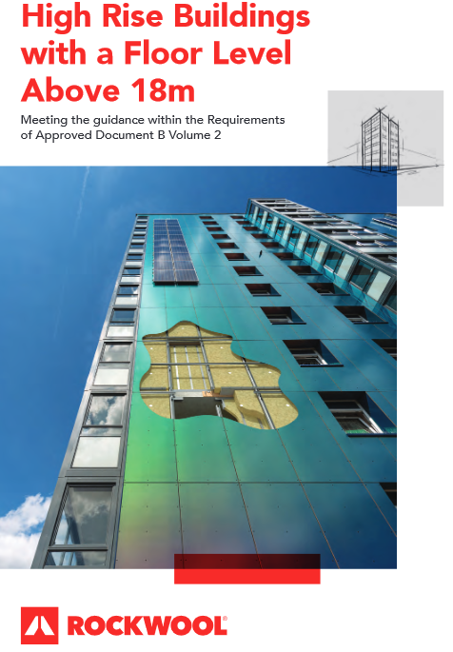
So, new regulation 7(2) applies to any building with a storey at least 18m above ground level containing one or more dwellings. By including institutions (which are defined in Regulation 2) it also covers some residential schools, care homes and hospitals, sheltered accommodation, student residences or other institutional accommodation blocks. The final group includes any building that contains ‘a room for residential purposes’.
Hostels, hotels or boarding houses are excluded, unless they are converted into residential, accommodation, such as student housing.
Tel: 0207 099 3636 * info@londonbuildingcontrol.co.uk * www.londonbuildingcontrol.co.uk
ISO9001 Certified

Slide 24
(3) Paragraph (2) does not apply to:
Cavity trays when used between two leaves of masonry;
Any part of a roof (other than any part of a rood which falls within paragraph (iv) of regulation 2(6)) if that part is connected to an external wall;
Door frames and doors;
Electrical installations;
Insulation and waterproofing materials used below ground level;
Tel: 0207 099 3636 * info@londonbuildingcontrol.co.uk * www.londonbuildingcontrol.co.uk
ISO9001 Certified

Slide 25
(f) Intumescent and fire stopping materials where the inclusion of the materials is necessary to meet the requirement of Part B of Schedule 1
(g) membranes;
(h) Seals, gaskets, fixings, sealants and backer rods;
Thermal break materials where necessary to prevent thermal bridging in order to meet the requirements of Part L of Schedule 1; or
(j) Window frames and glass.
Tel: 0207 099 3636 * info@londonbuildingcontrol.co.uk * www.londonbuildingcontrol.co.uk
ISO9001 Certified

Slide 26
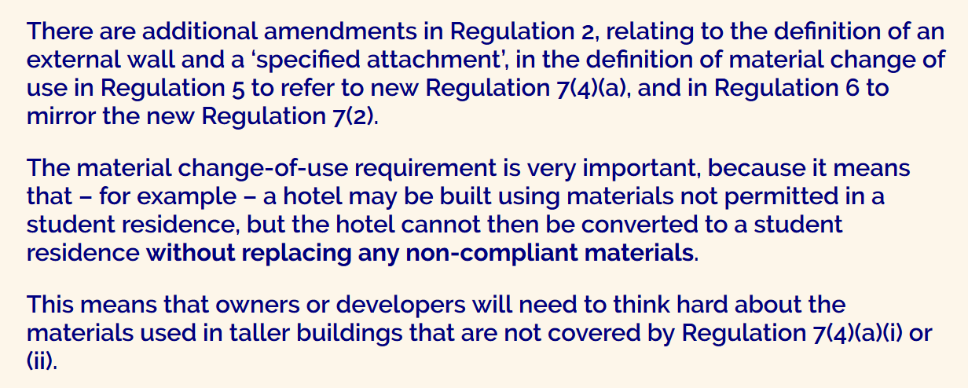
Tel: 0207 099 3636 * info@londonbuildingcontrol.co.uk * www.londonbuildingcontrol.co.uk
ISO9001 Certified

Slide 27
6.3 Definition of specified attachments
The restriction on combustibility also applies to materials used within “specified attachments” which are fixed to the external wall as shown below.
A balcony attached to an external wall;
A device for reducing heat gain within a building by deflecting sunlight which is attached to an external wall; or
A solar panel attached to an external wall.
Tel: 0207 099 3636 * info@londonbuildingcontrol.co.uk * www.londonbuildingcontrol.co.uk
ISO9001 Certified

Slide 28
This is a very specific list, and the restrictions on combustibility do not apply to other attachments that are not in this list. However, to comply with Requirement B4, it would still be necessary for the fire risk of other attachments to be considered before being introduced (i.e just because a particular attachment is not on the list, it does not mean that it is acceptable to use any materials, irrespective of combustibility).
The term “balcony” is often used in different ways. A “balcony” would often be a specific area used by one apartment. However, “balcony approach” is often used to describe the type of design where apartments are approached by a communal external balcony/walkway. FIA would suggest that the restrictions would apply to both of these definitions.
Tel: 0207 099 3636 * info@londonbuildingcontrol.co.uk * www.londonbuildingcontrol.co.uk
ISO9001 Certified

Slide 29
Forthcoming Potential Regulatory Procedural Changes
New National Safety Regulator for HRRB,s over 18metres in height.
Confirmed. Gateways 1 ,2 and 3
A new role created for a suitably qualified site Fire Safety inspector as part of the site team? Enhanced Clerk of Works? Currently unclear.
Potential for more onus put on physical design being right at the planning stage?
Tel: 0207 099 3636 * info@londonbuildingcontrol.co.uk * www.londonbuildingcontrol.co.uk
ISO9001 Certified

Slide 30
Forthcoming Potential Regulatory Procedural Changes
Non combustible wall requirements currently for over 18m reduced further to cover buildings over 11m?
The licensing of Regulatory bodies and the individual Regulators. Competence matrix?
Sprinkler requirements currently when over 30m reduced to cover designs over 18m. Potentially 11m?
Consultation returns produced no clear majority opinions on many of the suggested changes
Tel: 0207 099 3636 * info@londonbuildingcontrol.co.uk * www.londonbuildingcontrol.co.uk
ISO9001 Certified

Slide 31
View from the working party
Contractors observations - Materials with little flexibility to change later will push up purchase prices. Architects observations - More duty holder responsibility for overseeing their own design work. PII insurance issues.
Lawyers observations - Tendering may be legislated to ensure lowest price is not the overriding factor. Portugal and France as examples
Regulators observations - No firm agreement between the LABC, Fire Service and HSE on a suitable observation and reporting regime
Tel: 0207 099 3636 * info@londonbuildingcontrol.co.uk * www.londonbuildingcontrol.co.uk
ISO9001 Certified

Slide 32
Updates to Approved Document B 2nd April 2020
In May I will publish an update to Approved Document B that will include increased fire safety measures in high-rise blocks of flats. This follows the Government’s consultation between 5 September and 28 November 2019.
I can confirm that these measures will include provision of sprinkler systems and consistent wayfinding signage in all new high-rise blocks of flats over 11 metres tall. The provision of consistent wayfinding signage delivers on a recommendation from the Grenfell Public Inquiry phase 1 report. We will continue to work with the Home Office to respond to phase 1 recommendations, including through the Fire Safety Bill. Where this impacts on building design, the Approved Document will be amended again as necessary.
Tel: 0207 099 3636 * info@londonbuildingcontrol.co.uk * www.londonbuildingcontrol.co.uk
ISO9001 Certified

Slide 33
We also consulted on a requirement for evacuation alert systems. The Government will work with the National Fire Chiefs Council on a series of tests of new technology in this area, with a view to including guidance in a later update to Approved Document B.
I am also today publishing our plan for the full technical review of Approved Document B and a report containing recommendations on the structure of guidance to the building regulations. My Department is commissioning the required research for this fundamental review which will address a number of key fire safety issues including means of escape, compartmentation, toxicity and ensuring that fire safety guidance takes account of modern methods of construction
Tel: 0207 099 3636 * info@londonbuildingcontrol.co.uk * www.londonbuildingcontrol.co.uk
ISO9001 Certified

Slide 34
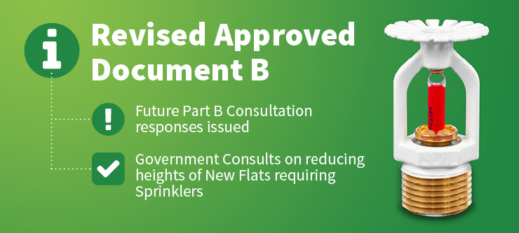
Regulations in response to the consultation could take 2- 3 years eg: Stay put
Tel: 0207 099 3636 * info@londonbuildingcontrol.co.uk * www.londonbuildingcontrol.co.uk
ISO9001 Certified

Slide 35
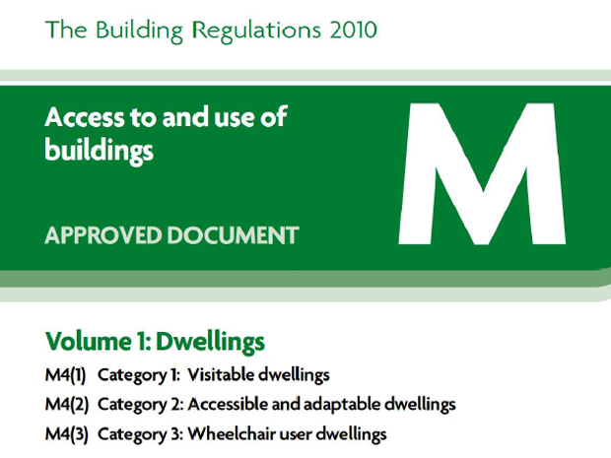
Part M Access Potential removal of Cat 1 resulting in Category 2 being the basepoint for new dwellings No decision yet taken or formal consultation has been undertaken* *MHCLG October 2019
Tel: 0207 099 3636 * info@londonbuildingcontrol.co.uk * www.londonbuildingcontrol.co.uk
ISO9001 Certified

Slide 36
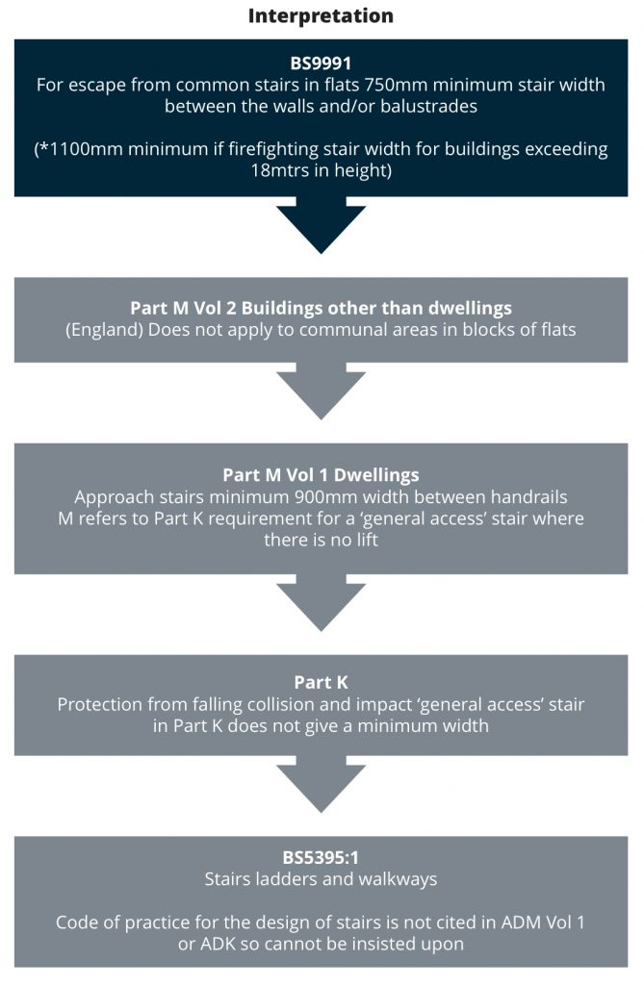
Harmonisation of requirements
The need to look at where different parts of the Regulations conflict Common stairs?
Parts B/K/M
Tel: 0207 099 3636 * info@londonbuildingcontrol.co.uk * www.londonbuildingcontrol.co.uk
ISO9001 Certified

Slide 37
And, just when you thought it couldn’t get any better;
Summary Proposals to alter existing residential and non-residential buildings regulations to include electric vehicle infrastructure requirements.
This consultation ran from 15 July 2019 to 11.45pm on 7 October 2019
Tel: 0207 099 3636 * info@londonbuildingcontrol.co.uk * www.londonbuildingcontrol.co.uk
ISO9001 Certified

Slide 38
Charging cars at home overnight using a dedicated charge point is generally cheaper and more convenient for consumers and ensures that EVs can play a full part in our future smart and flexible energy system. For these reasons, today to majority (around 80%) of all electric car charging happens at home and we expect the home to be central to the future charging ecosystem.
That is why in the Road to Zero strategy, the government sets out its intention for all new homes to be electric vehicle (EV) ready and committed to consult on requirements for every new home to have a charge point, where appropriate.
Tel: 0207 099 3636 * info@londonbuildingcontrol.co.uk * www.londonbuildingcontrol.co.uk
ISO9001 Certified

Slide 39
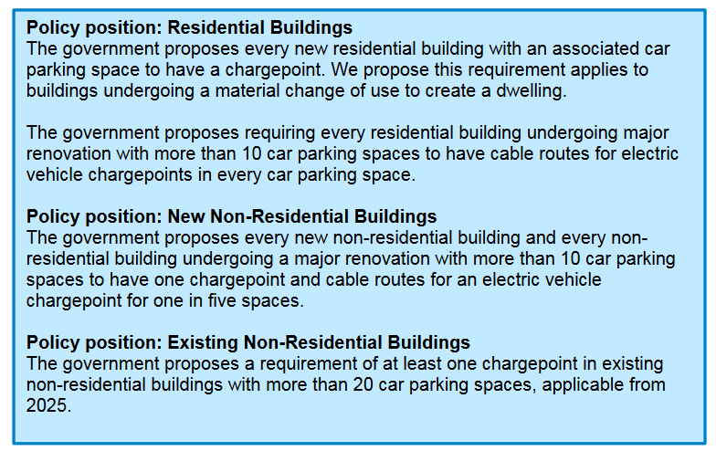
Tel: 0207 099 3636 * info@londonbuildingcontrol.co.uk * www.londonbuildingcontrol.co.uk
ISO9001 Certified

Slide 40
Thank you for listening
Tel: 0207 099 3636 * info@londonbuildingcontrol.co.uk * www.londonbuildingcontrol.co.uk
ISO9001 Certified

Slide 41
Head Office:
London Building Control,
13 Woodstock Street, Mayfair,
London, W1C 2AG
Tel: 0207 099 3636
www.londonbuildingcontrol.co.uk
info@londonbuildingcontrol.co.uk
Offices also in:
Chichester: 01243 882990
Manchester: 0161 660 0806
Welwyn Garden City: 01707 248611
Exeter: 01392 240770

